Slide 1
Website Analytics
by, Sheik Abdul Kather

Slide 2
Problem Statement
Data Analysis and Insights for different page Optimization & How to get more user install & Engagement from the App & Website
Assignment Discription:
As an intern in the Business Analytics team, your task is to analyze a provided dataset and generate actionable insights to optimize page performance for a fictional company called "XYZ Inc." The dataset contains user data from various regions, customer demographics, product information, and marketing campaign details. Your objective is to identify critical factors influencing Data Analysis and Insights for different page Optimization and how to get more user installation and engagement from the App and website" User and propose recommendations for improving performance.

Slide 3
Tools Used
Pandas
Matplot
Seaborn
Plotly

Slide 4
Data Contrarity
There exists an unidentified category in the gender report, it should be evident from the gender columns
Data is specified in the town/city column (not set) of the citi wise report.
Unidentified. age group category
Data is defined in pages and screen rports(not set)
Data User according to age
26342 users, 22872 new users
Gender specific data user
Its values ought to be the same.

Slide 5
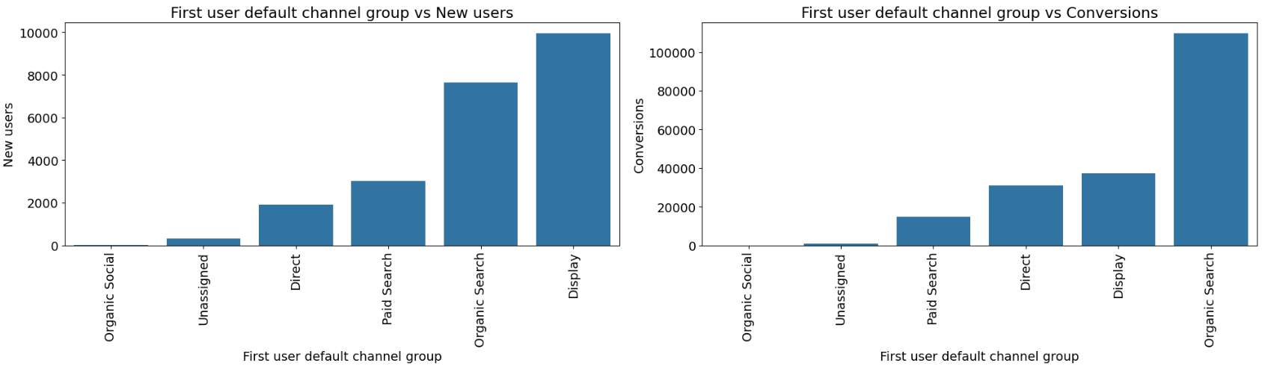
Organic Search are widely used here

Slide 6
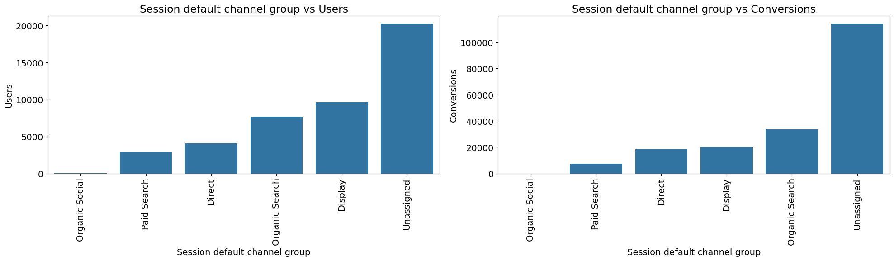
The Unassigned category beats organic search when it comes to conversions. Paid search should be improved for the conversion rate." The conversion rate is low in paid search.

Slide 7
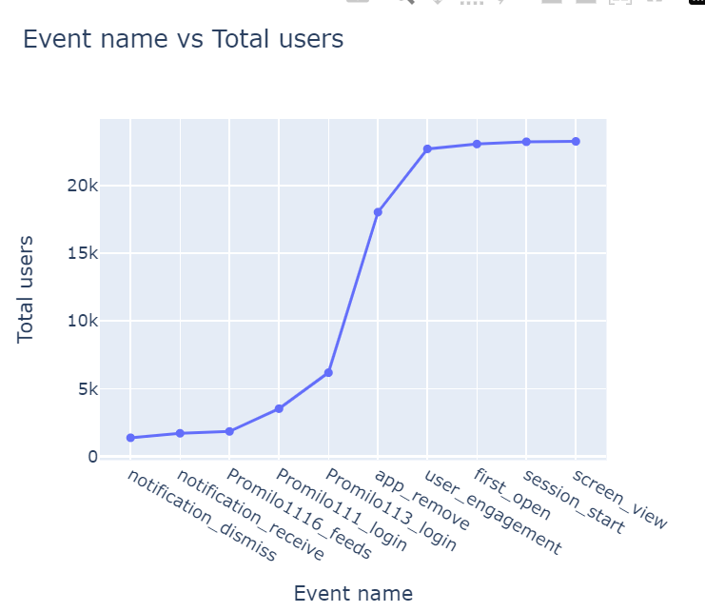
Screen View, Session Start and First open events are more consuming by users
Event Name

Slide 8
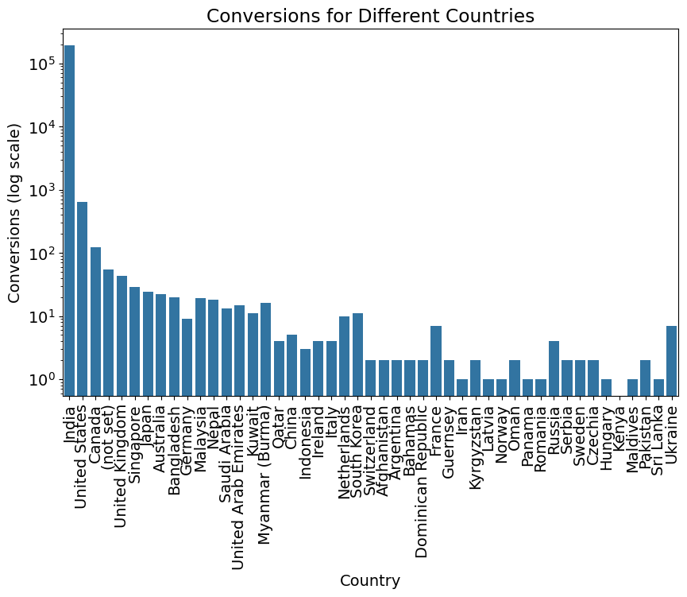
India is the Highest Conversion United States , Canada are the second and Third conversion among the countries.

Slide 9
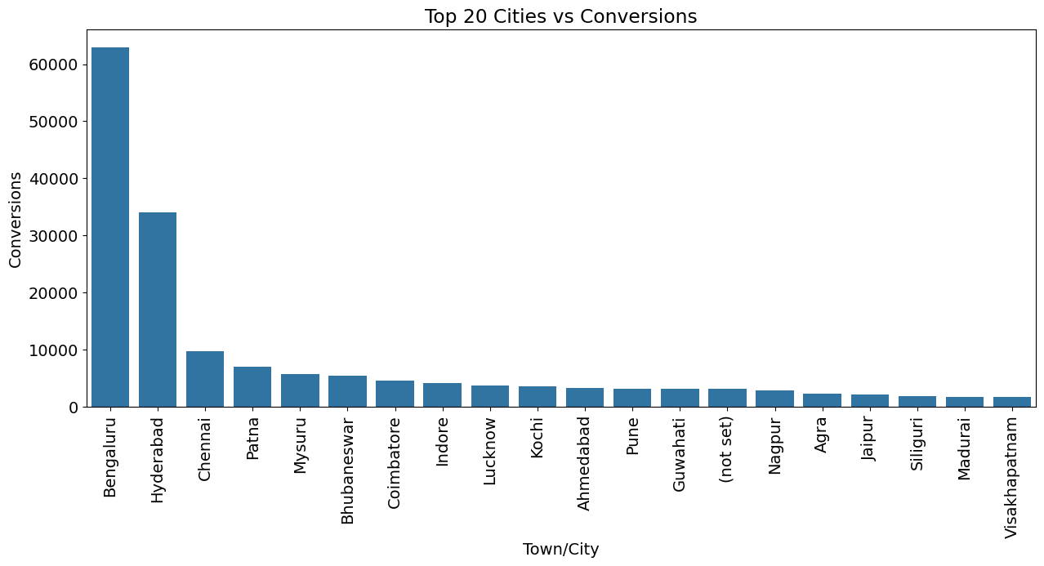
Bengaluru has most Convertion in India where as Hyderabad, Chennai are the second and Third among the top cities in India
Top 20 Cities in India

Slide 10
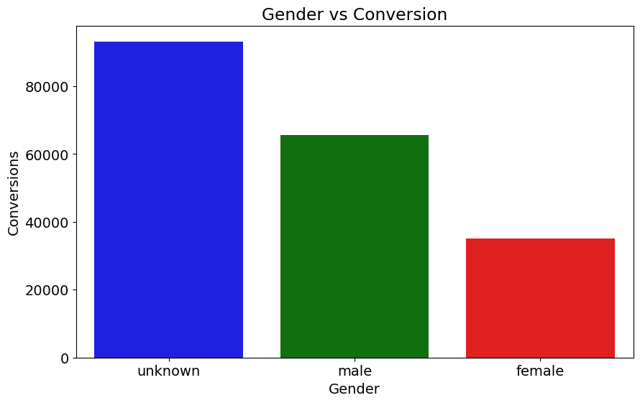
Gender Report
Unknown gender report are higher when compare with Male and Female

Slide 11
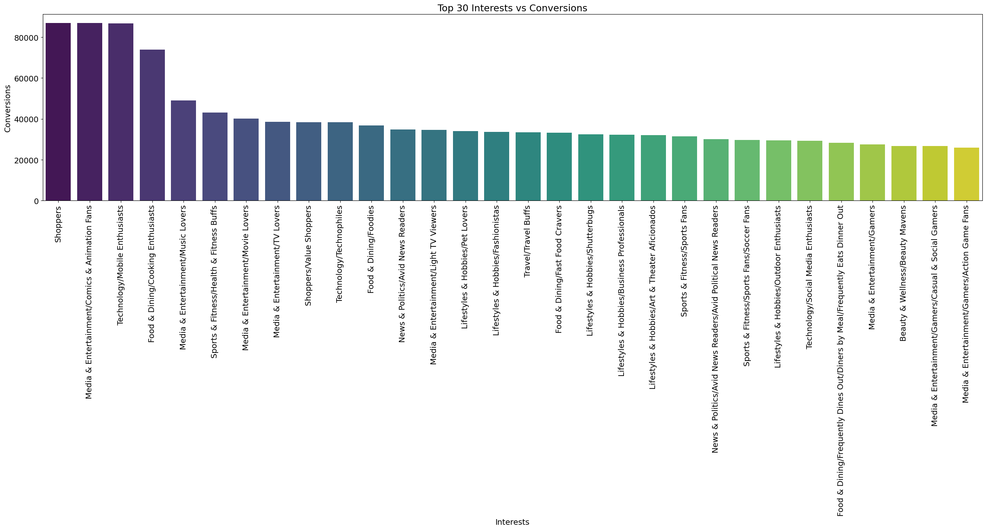
Top 30 Users by Interest
Shoppers is the Top most Interest among the users

Slide 12
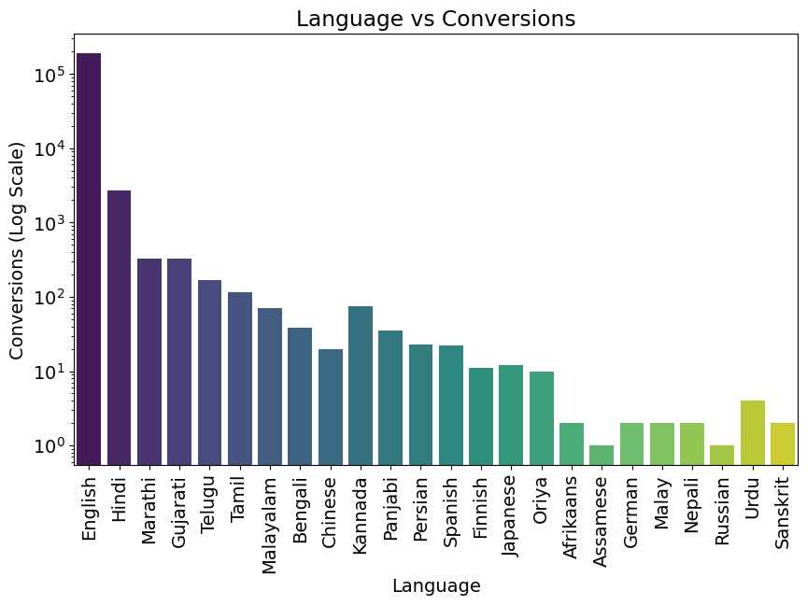
Language
For existing and newusers alike, English is the most widely used language. Thus, we must set English as a default language for our application.

Slide 13
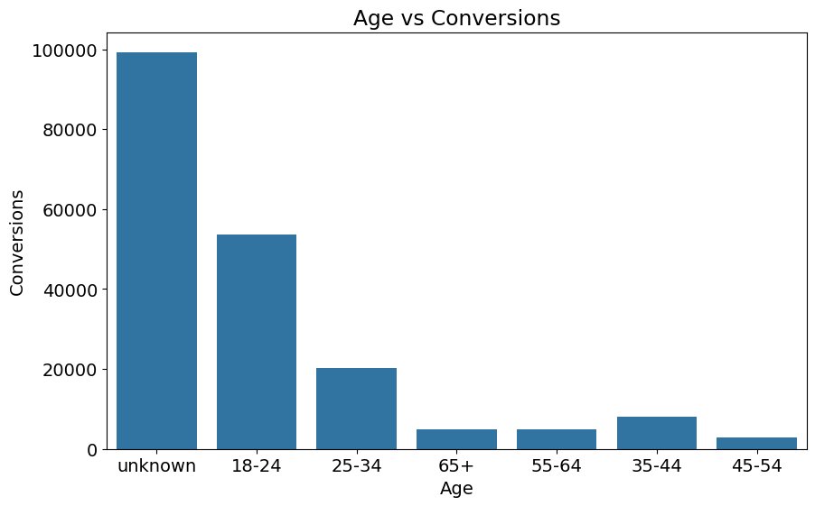
Age
There is a significant user base from unknown age group as evienced by the Unknown category’s high number of Engaged session(24,976) and Event Count(817,501). It is important to track and correctly assign people to their age group using user survey.
Among the age category that have been discovered that,the 18-24 Age group shows a promising amount of participation with (309,328) event count and (7,291 )participating sessions.

Slide 14

Analysis Report
User Acquisition: Organic search is the most importent factor among the user conversion.
Traffic Acquisition: Unasssigned category is crucial for conversion.
Event Report: Screen view, Session start, First opens are users engagement occurs more frequently among the user usages.
Conversion Report: Notifications plays a vital role in conversions. hen a customer sees a notification it triggers user engagement.
Page Path and Screen Class: If a conversion occurs, the login page appears more frequently. Login flutter, feeds are major components here.
Demographics Report: India has the highest conversion rate whereas Srilanka, Kenya has the lowest conversions among the list.
City wise Report: Bengaluru has the highest conversion rate followed by Hyderabad, Chennai are followed by them, where as Vishakapatinam has the lowest conversion rate.
Gender Report: User doesnot specify their gender, resulting in Unknown conversion, followed by Male have higher in result.
User by Interest: Users are interested in Shopping in higher followed by Media entertainment and Technology.

Slide 15
Analysis Report
User by Language: User use English as a primary language as a higher conversion followed by Hindi, Marati, Etc.,
User by Age: Unknown users are higher in range followed by 18-24 age as second higher users, whereas 45-54 has the lowest conversion rate.
Google Ads Report: Higher cost conversion during April app installation. whereas the amount paid for Google ads the conversion rate is very low.

Slide 16
Thanks！

